Slide 1
Dot Product
AKA the scalar product

Slide 2
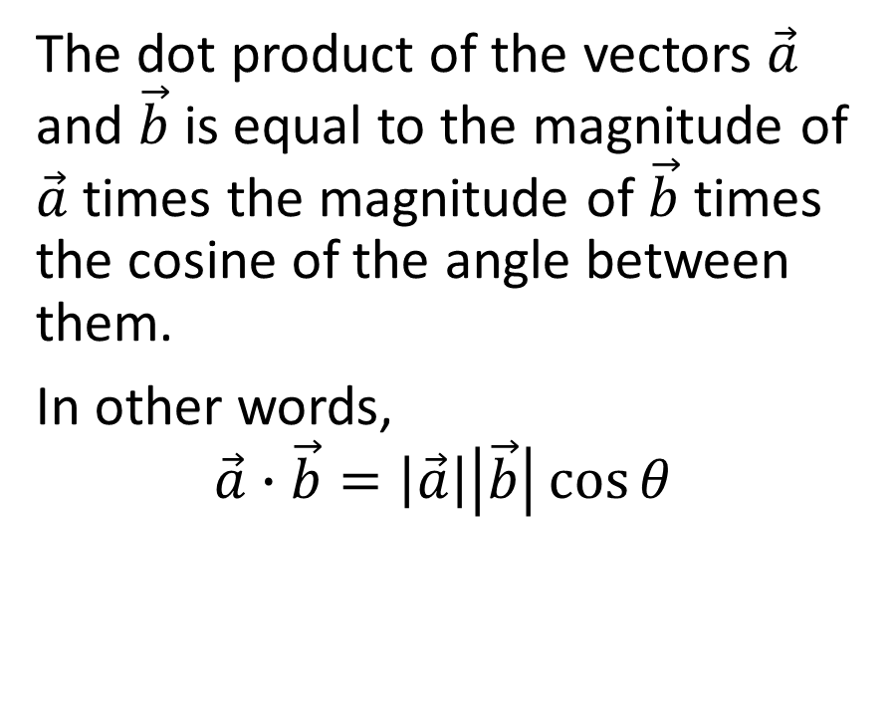
The dot product of the vectors $\vec{a}$ and $\vec{b}$ is equal to the magnitude of $\vec{a}$ times the magnitude of $\vec{b}$ times the cosine of the angle between them.
In other words,
$$\vec{a}∙\vec{b}=\left|\vec{a}\right|\left|\vec{b}\right|\cos{θ}$$

Slide 3

The dot product of the vectors $\vec{a}$ and $\vec{b}$ is equal to the magnitude of $\vec{a}$ times the magnitude of $\vec{b}$ times the cosine of the angle between them.
In other words,
$$\vec{a}∙\vec{b}=\left|\vec{a}\right|\left|\vec{b}\right|\cos{θ}$$
Example: Given the magnitude of $\vec{a}$ is 7, the magnitude of $\vec{b}$ is 4, and that there is an angle of 60° between $\vec{a}$ and $\vec{b}$, evaluate $\vec{a}∙\vec{b}$.

Slide 4
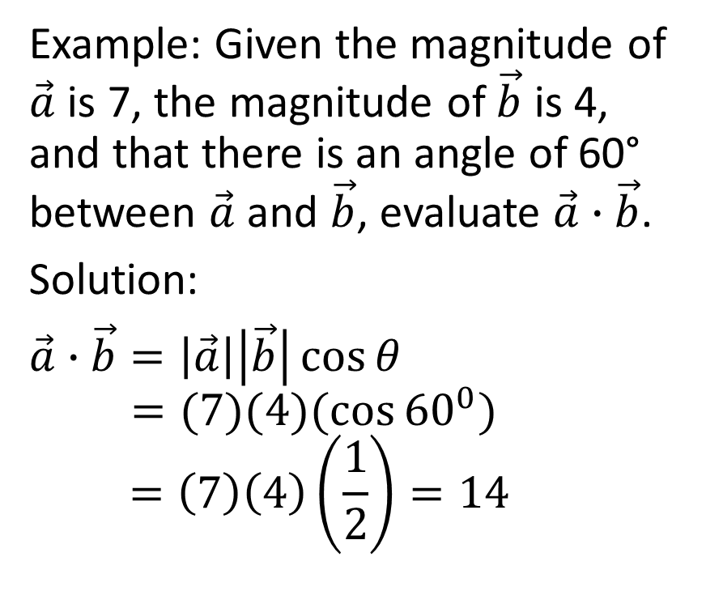
The dot product of the vectors $\vec{a}$ and $\vec{b}$ is equal to the magnitude of $\vec{a}$ times the magnitude of $\vec{b}$ times the cosine of the angle between them.
In other words,
$$\vec{a}∙\vec{b}=\left|\vec{a}\right|\left|\vec{b}\right|\cos{θ}$$
Example: Given the magnitude of $\vec{a}$ is 7, the magnitude of $\vec{b}$ is 4, and that there is an angle of 60° between $\vec{a}$ and $\vec{b}$, evaluate $\vec{a}∙\vec{b}$.
Solution:
$\vec{a}∙\vec{b}=\left|\vec{a}\right|\left|\vec{b}\right|\cos{θ}$
$$=(7)(4)(\cos{{60}^{0})}$$
$$=\left(7\right)\left(4\right)\left(\frac{1}{2}\right)=14$$

Slide 5

The dot product of the vectors $\vec{a}$ and $\vec{b}$ is equal to the magnitude of $\vec{a}$ times the magnitude of $\vec{b}$ times the cosine of the angle between them.
In other words,
$$\vec{a}∙\vec{b}=\left|\vec{a}\right|\left|\vec{b}\right|\cos{θ}$$
Example: Given the magnitude of $\vec{a}$ is 9, the magnitude of $\vec{b}$ is 5, and that there is an angle of 140° between $\vec{a}$ and $\vec{b}$, evaluate $\vec{a}∙\vec{b}$.

Slide 6
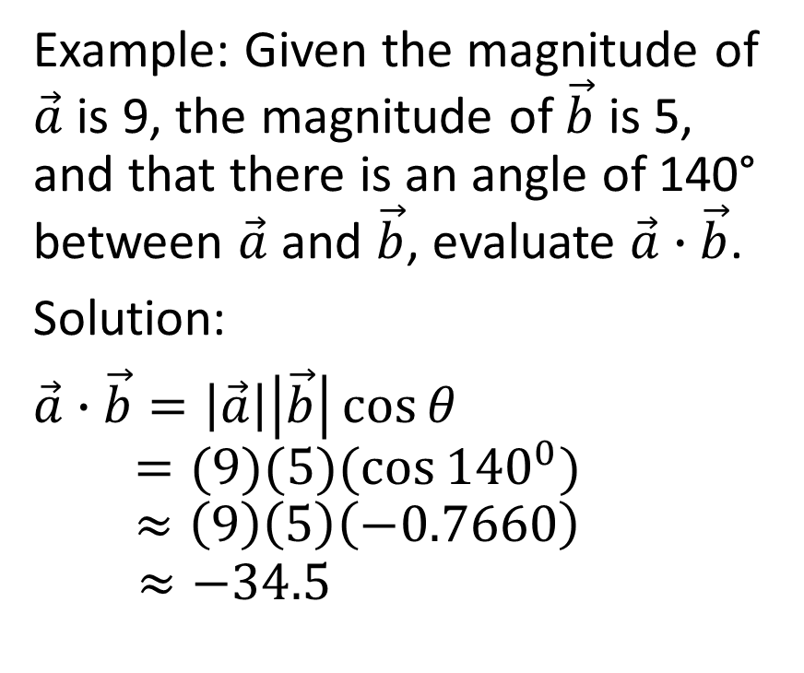
The dot product of the vectors $\vec{a}$ and $\vec{b}$ is equal to the magnitude of $\vec{a}$ times the magnitude of $\vec{b}$ times the cosine of the angle between them.
In other words,
$$\vec{a}∙\vec{b}=\left|\vec{a}\right|\left|\vec{b}\right|\cos{θ}$$
Example: Given the magnitude of $\vec{a}$ is 9, the magnitude of $\vec{b}$ is 5, and that there is an angle of 140° between $\vec{a}$ and $\vec{b}$, evaluate $\vec{a}∙\vec{b}$.
Solution:
$\vec{a}∙\vec{b}=\left|\vec{a}\right|\left|\vec{b}\right|\cos{θ}$
$$=(9)(5)(\cos{{140}^{0})}$$
$$≈\left(9\right)\left(5\right)\left(−0.7660\right)$$
$$≈−34.5$$

Slide 7

$$\vec{a}∙\vec{b}=\left|\vec{a}\right|\left|\vec{b}\right|\cos{θ}$$

Slide 8
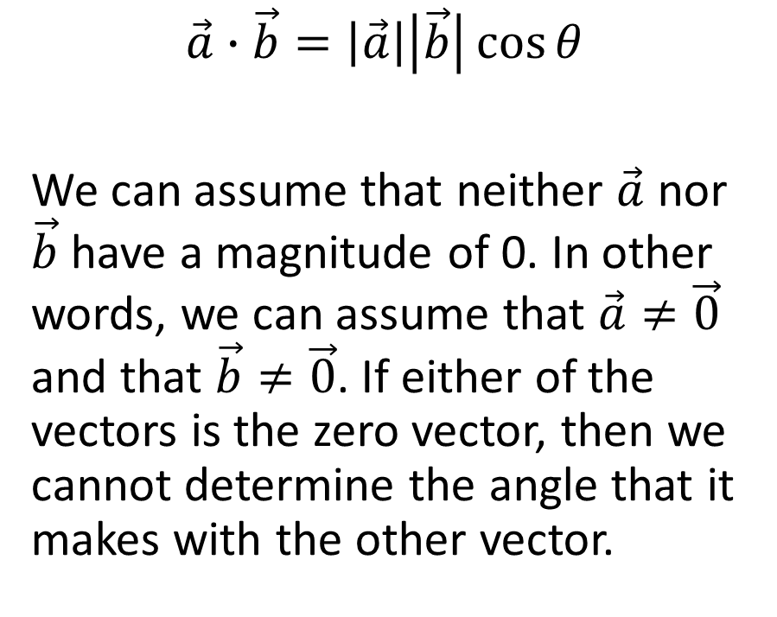
$$\vec{a}∙\vec{b}=\left|\vec{a}\right|\left|\vec{b}\right|\cos{θ}$$
We can assume that neither $\vec{a}$ nor $\vec{b}$ have a magnitude of 0. In other words, we can assume that $\vec{a}≠\vec{0}$ and that $\vec{b}≠\vec{0}$. If either of the vectors is the zero vector, then we cannot determine the angle that it makes with the other vector.

Slide 9
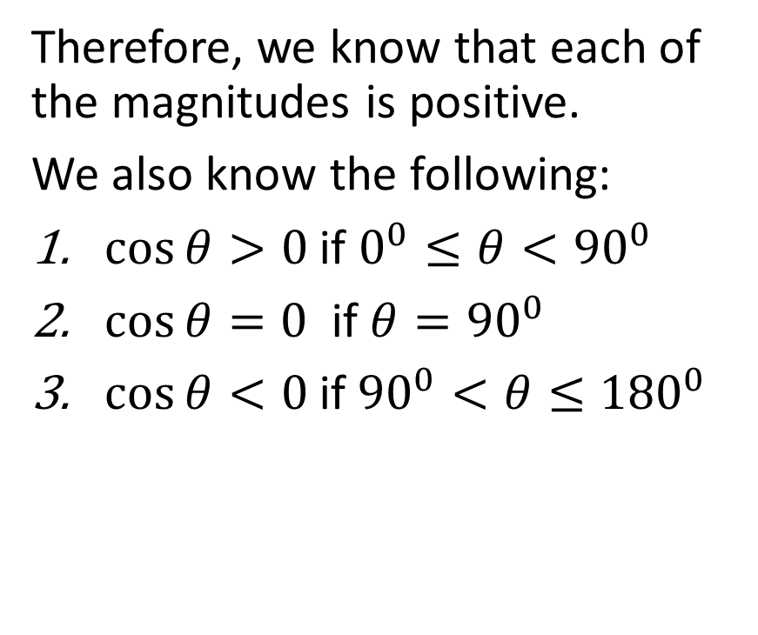
$$\vec{a}∙\vec{b}=\left|\vec{a}\right|\left|\vec{b}\right|\cos{θ}$$
We can assume that neither $\vec{a}$ nor $\vec{b}$ have a magnitude of 0. In other words, we can assume that $\vec{a}≠\vec{0}$ and that $\vec{b}≠\vec{0}$. If either of the vectors is the zero vector, then we cannot determine the angle that it makes with the other vector.
Therefore, we know that each of the magnitudes is positive.
We also know the following:
$\cos{θ>0}$ if $0^{0}≤θ<{90}^{0}$
$\cos{θ}=0$ if $θ={90}^{0}$
$\cos{θ}<0$if ${90}^{0}<θ≤{180}^{0}$

Slide 10
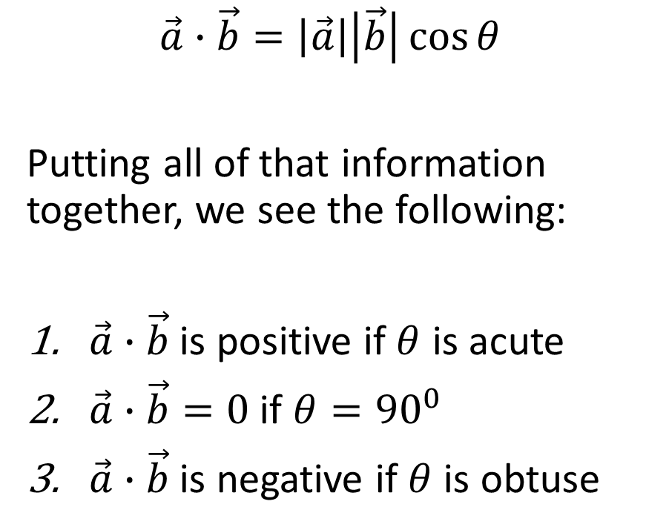
$$\vec{a}∙\vec{b}=\left|\vec{a}\right|\left|\vec{b}\right|\cos{θ}$$
Putting all of that information together, we see the following:
$\vec{a}∙\vec{b}$ is positive if $θ$ is acute
$\vec{a}∙\vec{b}=0$ if $θ={90}^{0}$
$\vec{a}∙\vec{b}$ is negative if $θ$ is obtuse

Slide 11
$$\vec{a}∙\vec{b}=\left|\vec{a}\right|\left|\vec{b}\right|\cos{θ}$$
Putting all of that information together, we see the following:
$\vec{a}∙\vec{b}$ is positive if $θ$ is acute
$\vec{a}∙\vec{b}=0$ if $θ={90}^{0}$
$\vec{a}∙\vec{b}$ is negative if $θ$ is obtuse
It’s a significant detail of this course that the dot product of two vectors is 0 if the vectors are perpendicular

Slide 12

Example
Determine the value of $\vec{a}∙\vec{a}$ given that $\left|\vec{a}\right|=7$

Slide 13
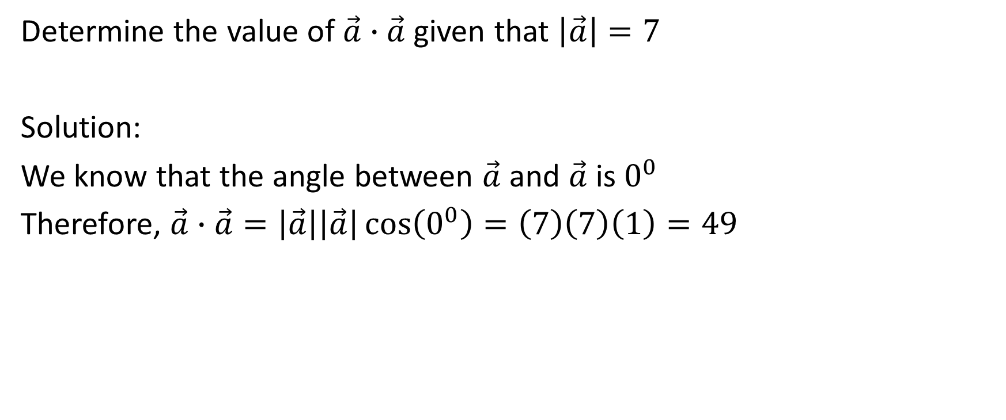
Determine the value of $\vec{a}∙\vec{a}$ given that $\left|\vec{a}\right|=7$
Solution:
We know that the angle between $\vec{a}$ and $\vec{a}$ is $0^{0}$
Therefore, $\vec{a}∙\vec{a}=\left|\vec{a}\right|\left|\vec{a}\right|\cos\left(0^{0}\right)=\left(7\right)\left(7\right)\left(1\right)=49$

Slide 14
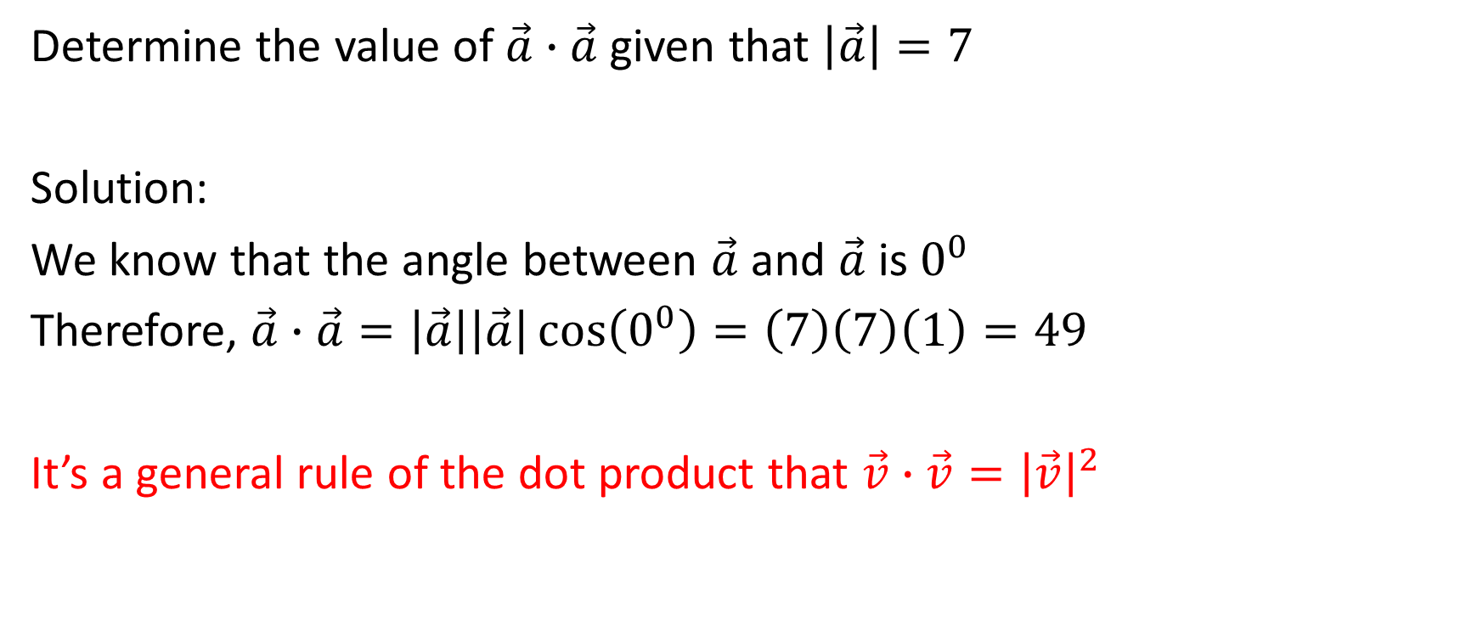
Determine the value of $\vec{a}∙\vec{a}$ given that $\left|\vec{a}\right|=7$
Solution:
We know that the angle between $\vec{a}$ and $\vec{a}$ is $0^{0}$
Therefore, $\vec{a}∙\vec{a}=\left|\vec{a}\right|\left|\vec{a}\right|\cos\left(0^{0}\right)=\left(7\right)\left(7\right)\left(1\right)=49$
It’s a general rule of the dot product that $\vec{v}∙\vec{v}={\left|\vec{v}\right|}^{2}$

Slide 15
Properties of the Dot Product

Slide 16

Properties of the Dot Product
$\vec{a}∙\vec{b}=\vec{b}∙\vec{a}$
$\left(m\vec{a}\right)∙\vec{b}=m\left(\vec{a}∙\vec{b}\right)$ For example, $\left(3\vec{a}\right)∙\vec{b}=3\left(\vec{a}∙\vec{b}\right)$
$\vec{a}∙\left(\vec{b}+\vec{c}\right)=\vec{a}∙\vec{b} + \vec{a}∙\vec{c}$
$\left(\vec{a}+\vec{b}\right)∙\left(\vec{c}+\vec{d}\right)=\vec{a}∙\vec{c} + \vec{a}∙\vec{d} + \vec{b}∙\vec{c} + \vec{b}∙\vec{d}$

Slide 17

Example
Suppose the vectors $\vec{a}+3\vec{b}$ and $4\vec{a}−\vec{b}$ are perpendicular and suppose that $\left|\vec{a}\right|=2\left|\vec{b}\right|$. Determine the angle between the vectors $\vec{a}$ and $\vec{b}$.

Slide 18
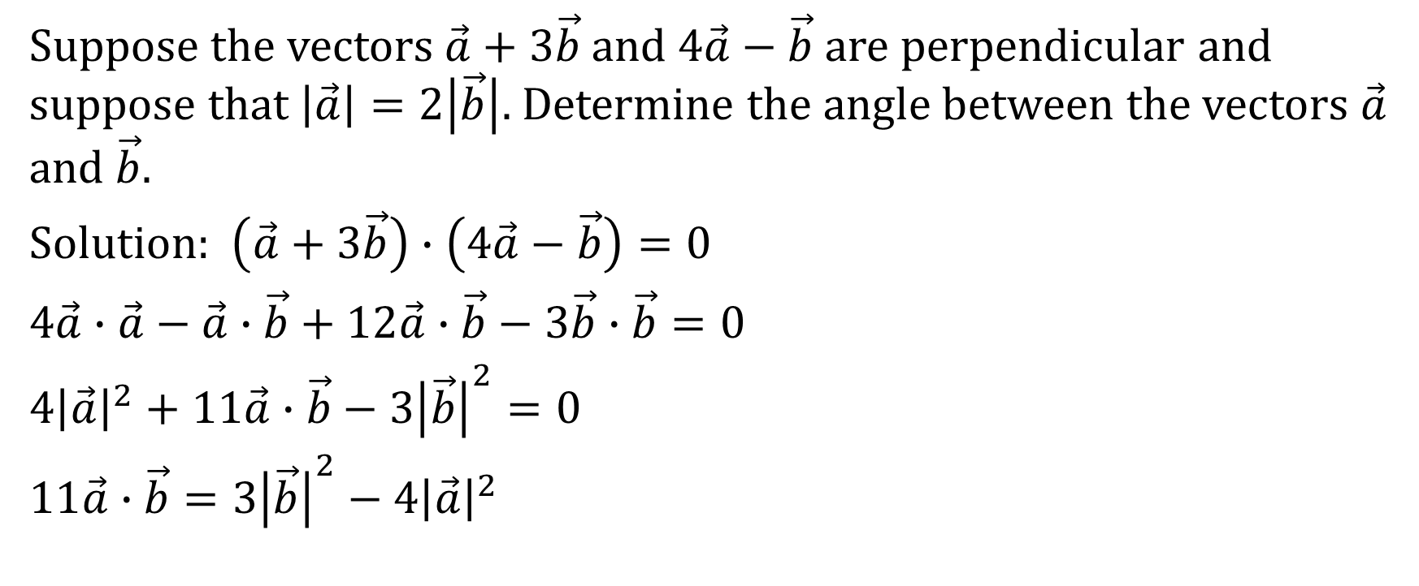
Suppose the vectors $\vec{a}+3\vec{b}$ and $4\vec{a}−\vec{b}$ are perpendicular and suppose that $\left|\vec{a}\right|=2\left|\vec{b}\right|$. Determine the angle between the vectors $\vec{a}$ and $\vec{b}$.
Solution: $\left(\vec{a}+3\vec{b}\right)∙\left(4\vec{a}−\vec{b}\right)=0$
$4\vec{a}∙\vec{a}−\vec{a}∙\vec{b}+12\vec{a}∙\vec{b}−3\vec{b}∙\vec{b}=0$
$4{\left|\vec{a}\right|}^{2}+11\vec{a}∙\vec{b}−3{\left|\vec{b}\right|}^{2}=0$
$11\vec{a}∙\vec{b}=3{\left|\vec{b}\right|}^{2}−4{\left|\vec{a}\right|}^{2}$

Slide 19

Suppose the vectors $\vec{a}+3\vec{b}$ and $4\vec{a}−\vec{b}$ are perpendicular and suppose that $\left|\vec{a}\right|=2\left|\vec{b}\right|$. Determine the angle between the vectors $\vec{a}$ and $\vec{b}$.
Solution: $11\vec{a}∙\vec{b}=3{\left|\vec{b}\right|}^{2}−4{\left|\vec{a}\right|}^{2}$

Slide 20
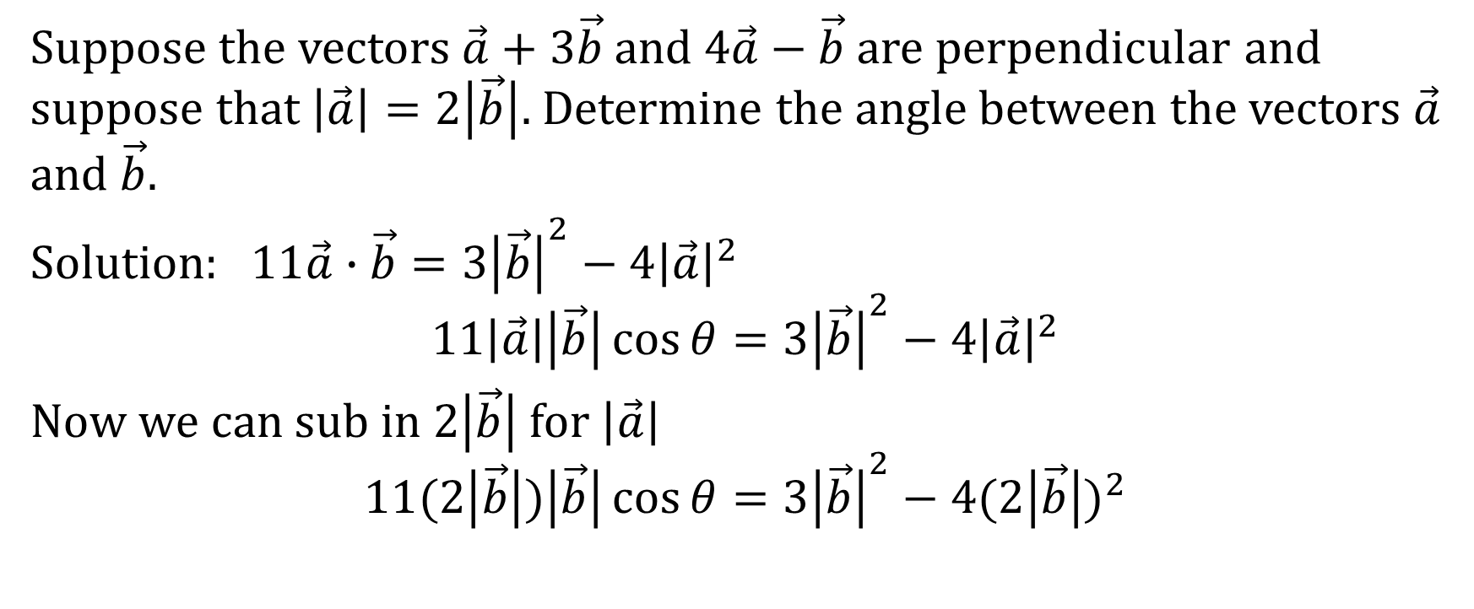
Suppose the vectors $\vec{a}+3\vec{b}$ and $4\vec{a}−\vec{b}$ are perpendicular and suppose that $\left|\vec{a}\right|=2\left|\vec{b}\right|$. Determine the angle between the vectors $\vec{a}$ and $\vec{b}$.
Solution: $11\vec{a}∙\vec{b}=3{\left|\vec{b}\right|}^{2}−4{\left|\vec{a}\right|}^{2}$
$$11\left|\vec{a}\right|\left|\vec{b}\right|\cos{θ}=3{\left|\vec{b}\right|}^{2}−4{\left|\vec{a}\right|}^{2}$$
Now we can sub in $2\left|\vec{b}\right|$ for $\left|\vec{a}\right|$
$$11(2\left|\vec{b}\right|)\left|\vec{b}\right|\cos{θ}=3{\left|\vec{b}\right|}^{2}−4{(2\left|\vec{b}\right|)}^{2}$$

Slide 21

Suppose the vectors $\vec{a}+3\vec{b}$ and $4\vec{a}−\vec{b}$ are perpendicular and suppose that $\left|\vec{a}\right|=2\left|\vec{b}\right|$. Determine the angle between the vectors $\vec{a}$ and $\vec{b}$.
Solution: $11(2\left|\vec{b}\right|)\left|\vec{b}\right|\cos{θ}=3{\left|\vec{b}\right|}^{2}−4{(2\left|\vec{b}\right|)}^{2}$

Slide 22
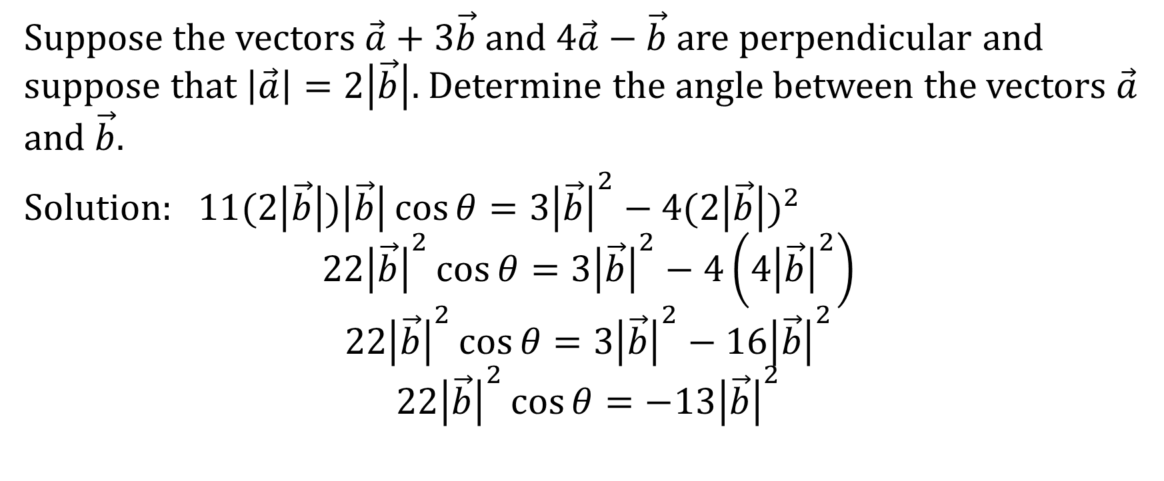
Suppose the vectors $\vec{a}+3\vec{b}$ and $4\vec{a}−\vec{b}$ are perpendicular and suppose that $\left|\vec{a}\right|=2\left|\vec{b}\right|$. Determine the angle between the vectors $\vec{a}$ and $\vec{b}$.
Solution: $11(2\left|\vec{b}\right|)\left|\vec{b}\right|\cos{θ}=3{\left|\vec{b}\right|}^{2}−4{(2\left|\vec{b}\right|)}^{2}$
$$22{\left|\vec{b}\right|}^{2}\cos{θ}=3{\left|\vec{b}\right|}^{2}−4\left(4{\left|\vec{b}\right|}^{2}\right)$$
$$22{\left|\vec{b}\right|}^{2}\cos{θ}=3{\left|\vec{b}\right|}^{2}−16{\left|\vec{b}\right|}^{2}$$
$$22{\left|\vec{b}\right|}^{2}\cos{θ}=−13{\left|\vec{b}\right|}^{2}$$

Slide 23
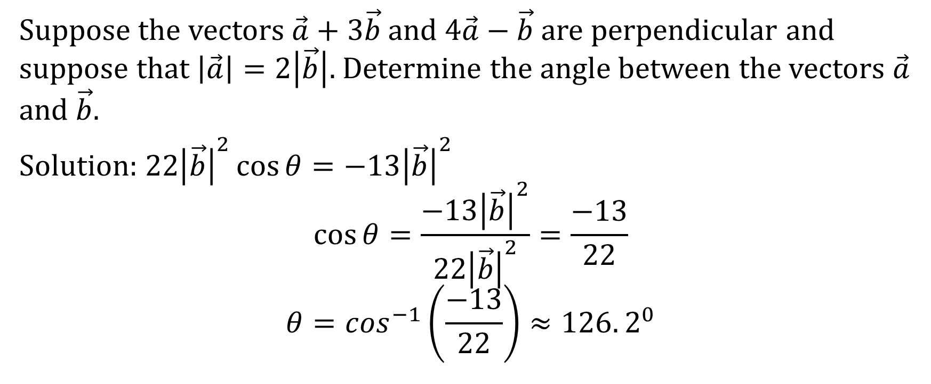
Suppose the vectors $\vec{a}+3\vec{b}$ and $4\vec{a}−\vec{b}$ are perpendicular and suppose that $\left|\vec{a}\right|=2\left|\vec{b}\right|$. Determine the angle between the vectors $\vec{a}$ and $\vec{b}$.
Solution: $22{\left|\vec{b}\right|}^{2}\cos{θ}=−13{\left|\vec{b}\right|}^{2}$
$$\cos{θ}=\frac{−13{\left|\vec{b}\right|}^{2}}{22{\left|\vec{b}\right|}^{2}}=\frac{−13}{22}$$
$$θ=\cos^{−1}\left(\frac{−13}{22}\right)≈126.2^{0}$$

Slide 24
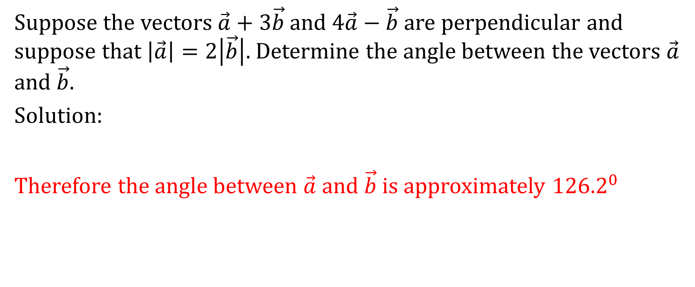
Suppose the vectors $\vec{a}+3\vec{b}$ and $4\vec{a}−\vec{b}$ are perpendicular and suppose that $\left|\vec{a}\right|=2\left|\vec{b}\right|$. Determine the angle between the vectors $\vec{a}$ and $\vec{b}$.
Solution:
Therefore the angle between $\vec{a}$ and $\vec{b}$ is approximately ${126.2}^{0}$

Slide 25

Example
If $\left|\vec{x}+\vec{y}\right|=\left|\vec{x}−\vec{y}\right|$, then prove that the non-zero vectors $\vec{x}$ and $\vec{y}$ are perpendicular.

Slide 26
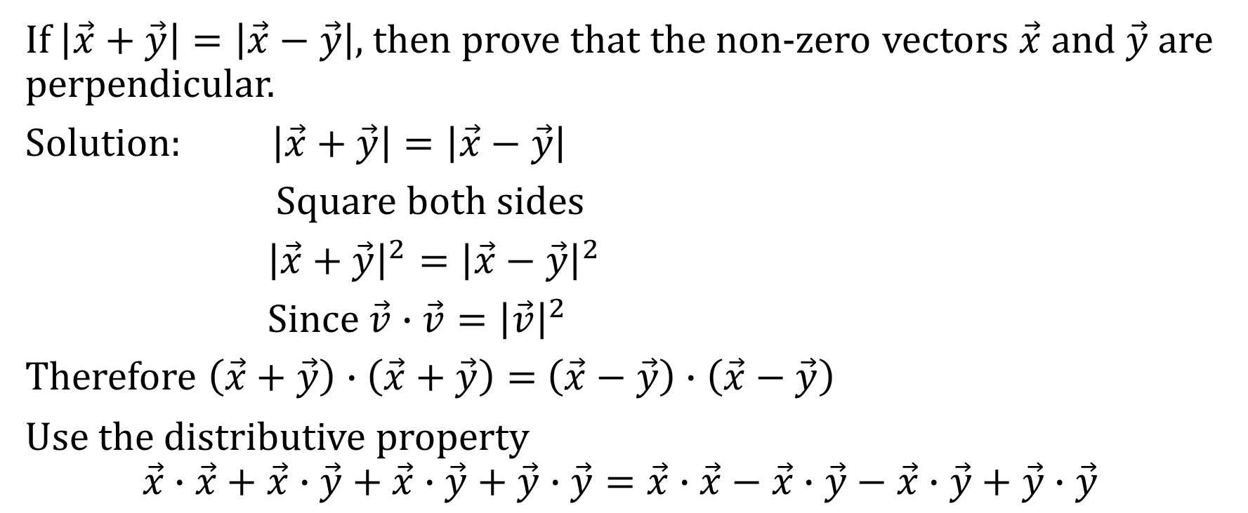
If $\left|\vec{x}+\vec{y}\right|=\left|\vec{x}−\vec{y}\right|$, then prove that the non-zero vectors $\vec{x}$ and $\vec{y}$ are perpendicular.
Solution: $\left|\vec{x}+\vec{y}\right|=\left|\vec{x}−\vec{y}\right|$
Square both sides
${\left|\vec{x}+\vec{y}\right|}^{2}={\left|\vec{x}−\vec{y}\right|}^{2}$
Since $\vec{v}∙\vec{v}={\left|\vec{v}\right|}^{2}$
Therefore $\left(\vec{x}+\vec{y}\right)∙\left(\vec{x}+\vec{y}\right)=$ $\left(\vec{x}−\vec{y}\right)∙\left(\vec{x}−\vec{y}\right)$
Use the distributive property
$$\vec{x}∙\vec{x}+\vec{x}∙\vec{y}+\vec{x}∙\vec{y}+\vec{y}∙\vec{y}=\vec{x}∙\vec{x}−\vec{x}∙\vec{y}−\vec{x}∙\vec{y}+\vec{y}∙\vec{y}$$

Slide 27
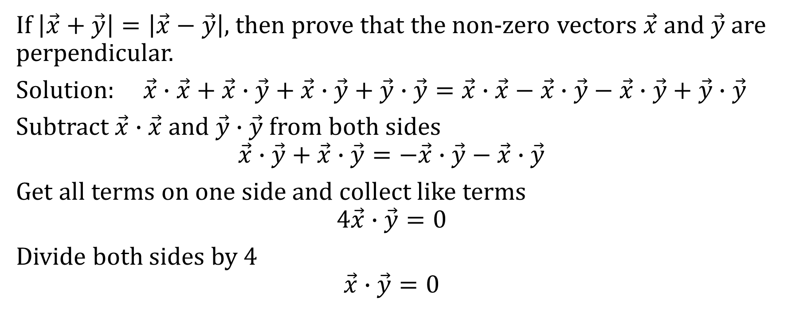
If $\left|\vec{x}+\vec{y}\right|=\left|\vec{x}−\vec{y}\right|$, then prove that the non-zero vectors $\vec{x}$ and $\vec{y}$ are perpendicular.
Solution: $\vec{x}∙\vec{x}+\vec{x}∙\vec{y}+\vec{x}∙\vec{y}+\vec{y}∙\vec{y}=\vec{x}∙\vec{x}−\vec{x}∙\vec{y}−\vec{x}∙\vec{y}+\vec{y}∙\vec{y}$
Subtract $\vec{x}∙\vec{x}$ and $\vec{y}∙\vec{y}$ from both sides
$$\vec{x}∙\vec{y}+\vec{x}∙\vec{y}=−\vec{x}∙\vec{y}−\vec{x}∙\vec{y}$$
Get all terms on one side and collect like terms
$$4\vec{x}∙\vec{y}=0$$
Divide both sides by 4
$$\vec{x}∙\vec{y}=0$$

Slide 28

If $\left|\vec{x}+\vec{y}\right|=\left|\vec{x}−\vec{y}\right|$, then prove that the non-zero vectors $\vec{x}$ and $\vec{y}$ are perpendicular.
Solution: $\vec{x}∙\vec{y}=0$

Slide 29
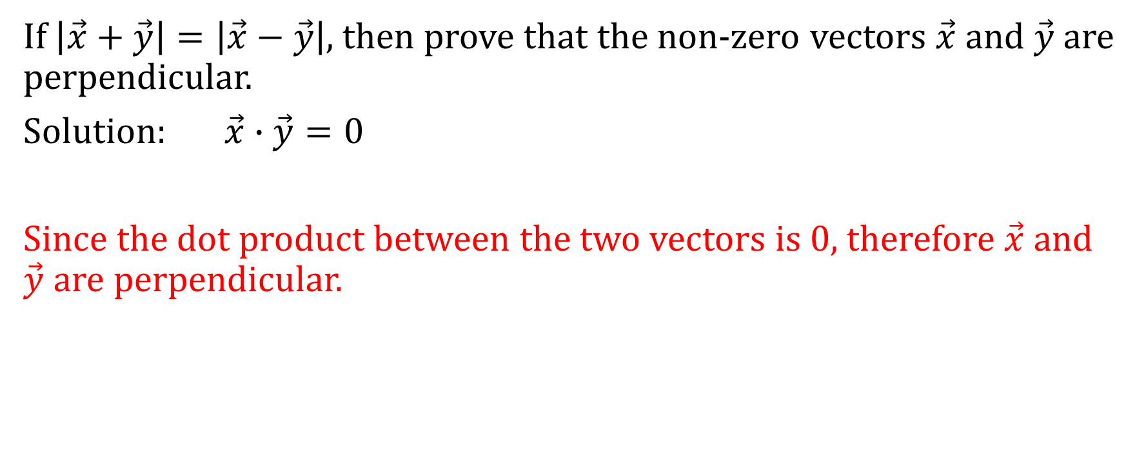
If $\left|\vec{x}+\vec{y}\right|=\left|\vec{x}−\vec{y}\right|$, then prove that the non-zero vectors $\vec{x}$ and $\vec{y}$ are perpendicular.
Solution: $\vec{x}∙\vec{y}=0$
Since the dot product between the two vectors is 0, therefore $\vec{x}$ and $\vec{y}$ are perpendicular.

